Slide 1




Website: http://www.mit-ivy.com
MIT -IVY INDUSTRY Co.,Ltd
Phone/whatsapp+ 86-13805212761
Email: info@mit-ivy.com

Slide 2

目 录
CATALOG
01
02
03
04
公司介绍
公司团队
公司产品
发展规划
COMPANY
TEAM
PRODUCT
CUSTOMER

Slide 3
01
公司介绍
MIT-IVY INDUSTRY COMPANY

Slide 4

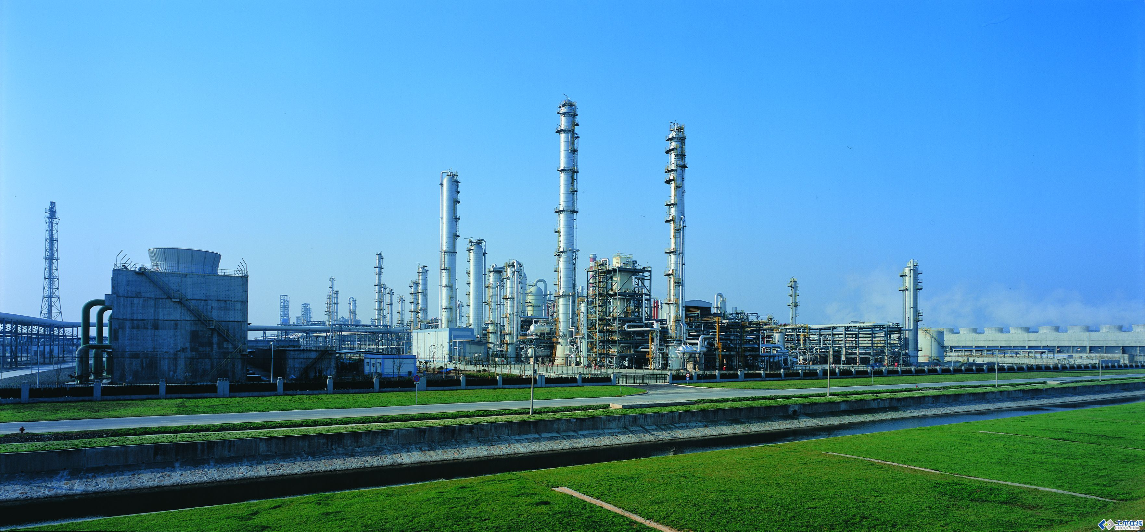
ABOUT COMPANY
MIT –IVY Industry supplier of Fine chemicals， N-alkylated aniline series products ，organic intermediates.& specialty chemicals ,Leading products N- methyl aniline series, N- ethyl aniline series annual output of tens of thousands of tons.
We provide with quality products, timely delivery, technology and best in-class services .
Our company with mature technology, reliable quality products in the domestic and foreign markets enjoy a certain reputation.
We know only by delivering you the solution and solving the problem, we can make our profit.
With excellent product quality, product consistency and strict safety and environmental protection controls, we have made our name throughout the world.MIT-IVY INDUSTRY has been working closely with many global chemical companies such as Archroma, BASF,Indulor Sun Chemical and etc.

Slide 5
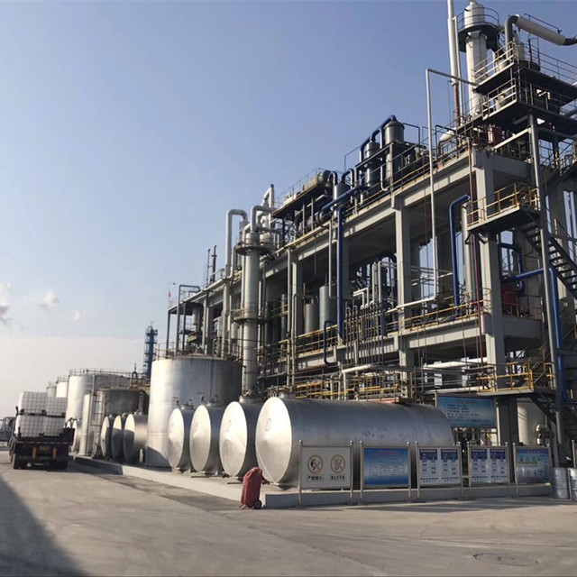
ABOUT FACTOURY
MIT -IVY Industry use advance d production technology and test methods to realize production, quality controlling to meet the standard. We have been approved by REACH CETIFICATION ,SGS, ISO9001, ISO140 01, GB/HS16949 and T28001.
Technology is the first productive force. It uses science and technology to create a brand, constantly adapts and meets the diverse needs of the market and customers, in order to realize the highest value of the company.
MIT -IVY Industry hold “Integrity as root, technology s foundation,quality superiority,and top service”to produce our goods in International standard,our main technology index all meet International standard. We always believe that technology is the first productive force to creat “first class “brand to make out company among the top in this line.
So we also set up its own laboratory, hired excellent scientific and technical management personnel, give priority to the development of science and technology, and strive to be the best in the industry.

Slide 6


MIOT-IVY INDUSTRY FOCUS
The leaders pay more attention to the management of the strategic development, transformation and upgrading while playing to their strengths.There is management innovation in strategic, marketing,HR and financial management. Also, the company execute fine management on the manufacturing just aims to be the one which has great influence among the ones with same occupation and tries to be the example in standardized management in certain district.
With honesty and credit as our idea, with high-class technology, stable quality, nicer service, suitable price and brand promotion, MIT-IVY is looking forward to cooperating with all the friends, and going to the brightly future.
Professional
Faith
Development
Cooperation
Innovation

Slide 7
COMPANY HIGHLIGHT
2008-2012
1996
1996-2000
2009
The spray drying device of Acid black 177 by the national ministry of science and technology as "national torch plan project" in Sept. 2009
The company was formally established in April 1996
2012
2012-2015
By 2012, Named as Harmonious Enterprise
2006
2002-2008
2017
By 2006 passed the SO9000, ISO14000 certification
2001
2017
2000-2002
By 2001 opening of ERP financial management software,standardizeo
financial management
In OCT 2017, the mass production for DMA began in jiangsu EAST IVY Fine Chenical Co..Ltd.

Slide 8


FAITH-BASED TECHNOLOGICAL INNOVATION
Management is the basis, Quality is the life Benefit is the fundmental, Market is the guide and Technology is the leader
Tenet
1
people-oriented, revitalizing the enerprise by science and technology, always to be the first and unceasingly transcends ourselives
2
Culture
Philosophy
Honesty, Professional, innovation, keep improving and put customers first.
3
Target
4
to build a century enterprise, to creat a century sunshine

Slide 9
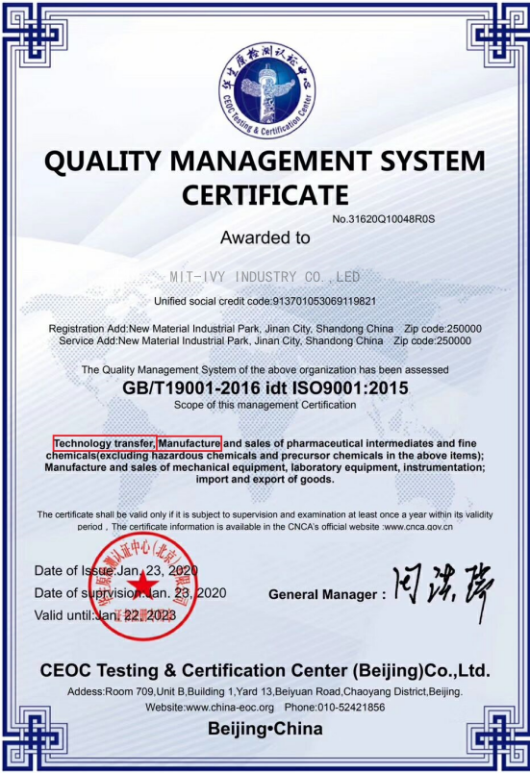
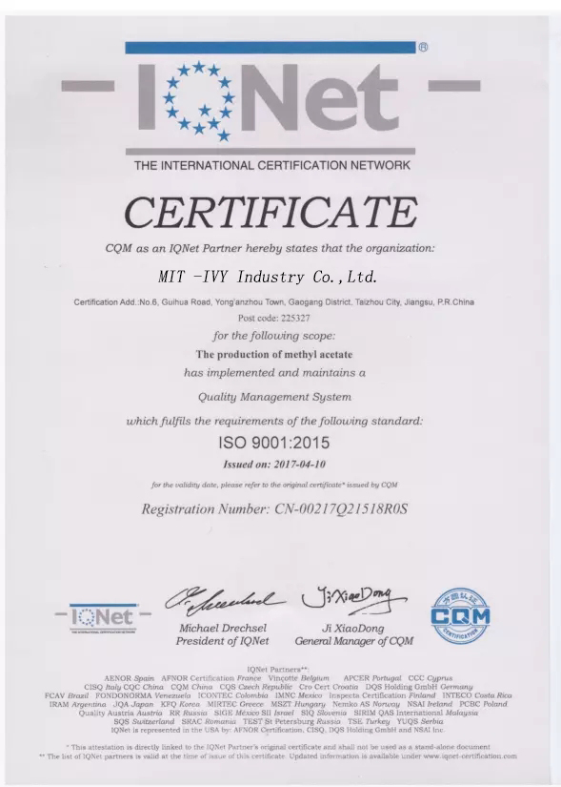
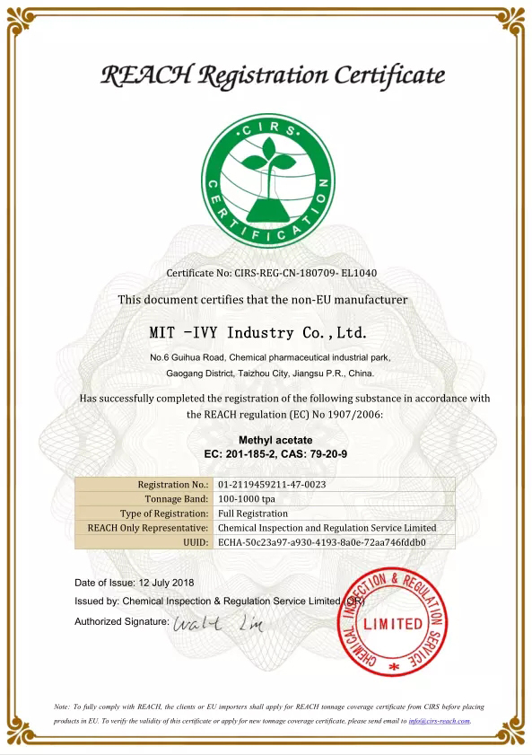
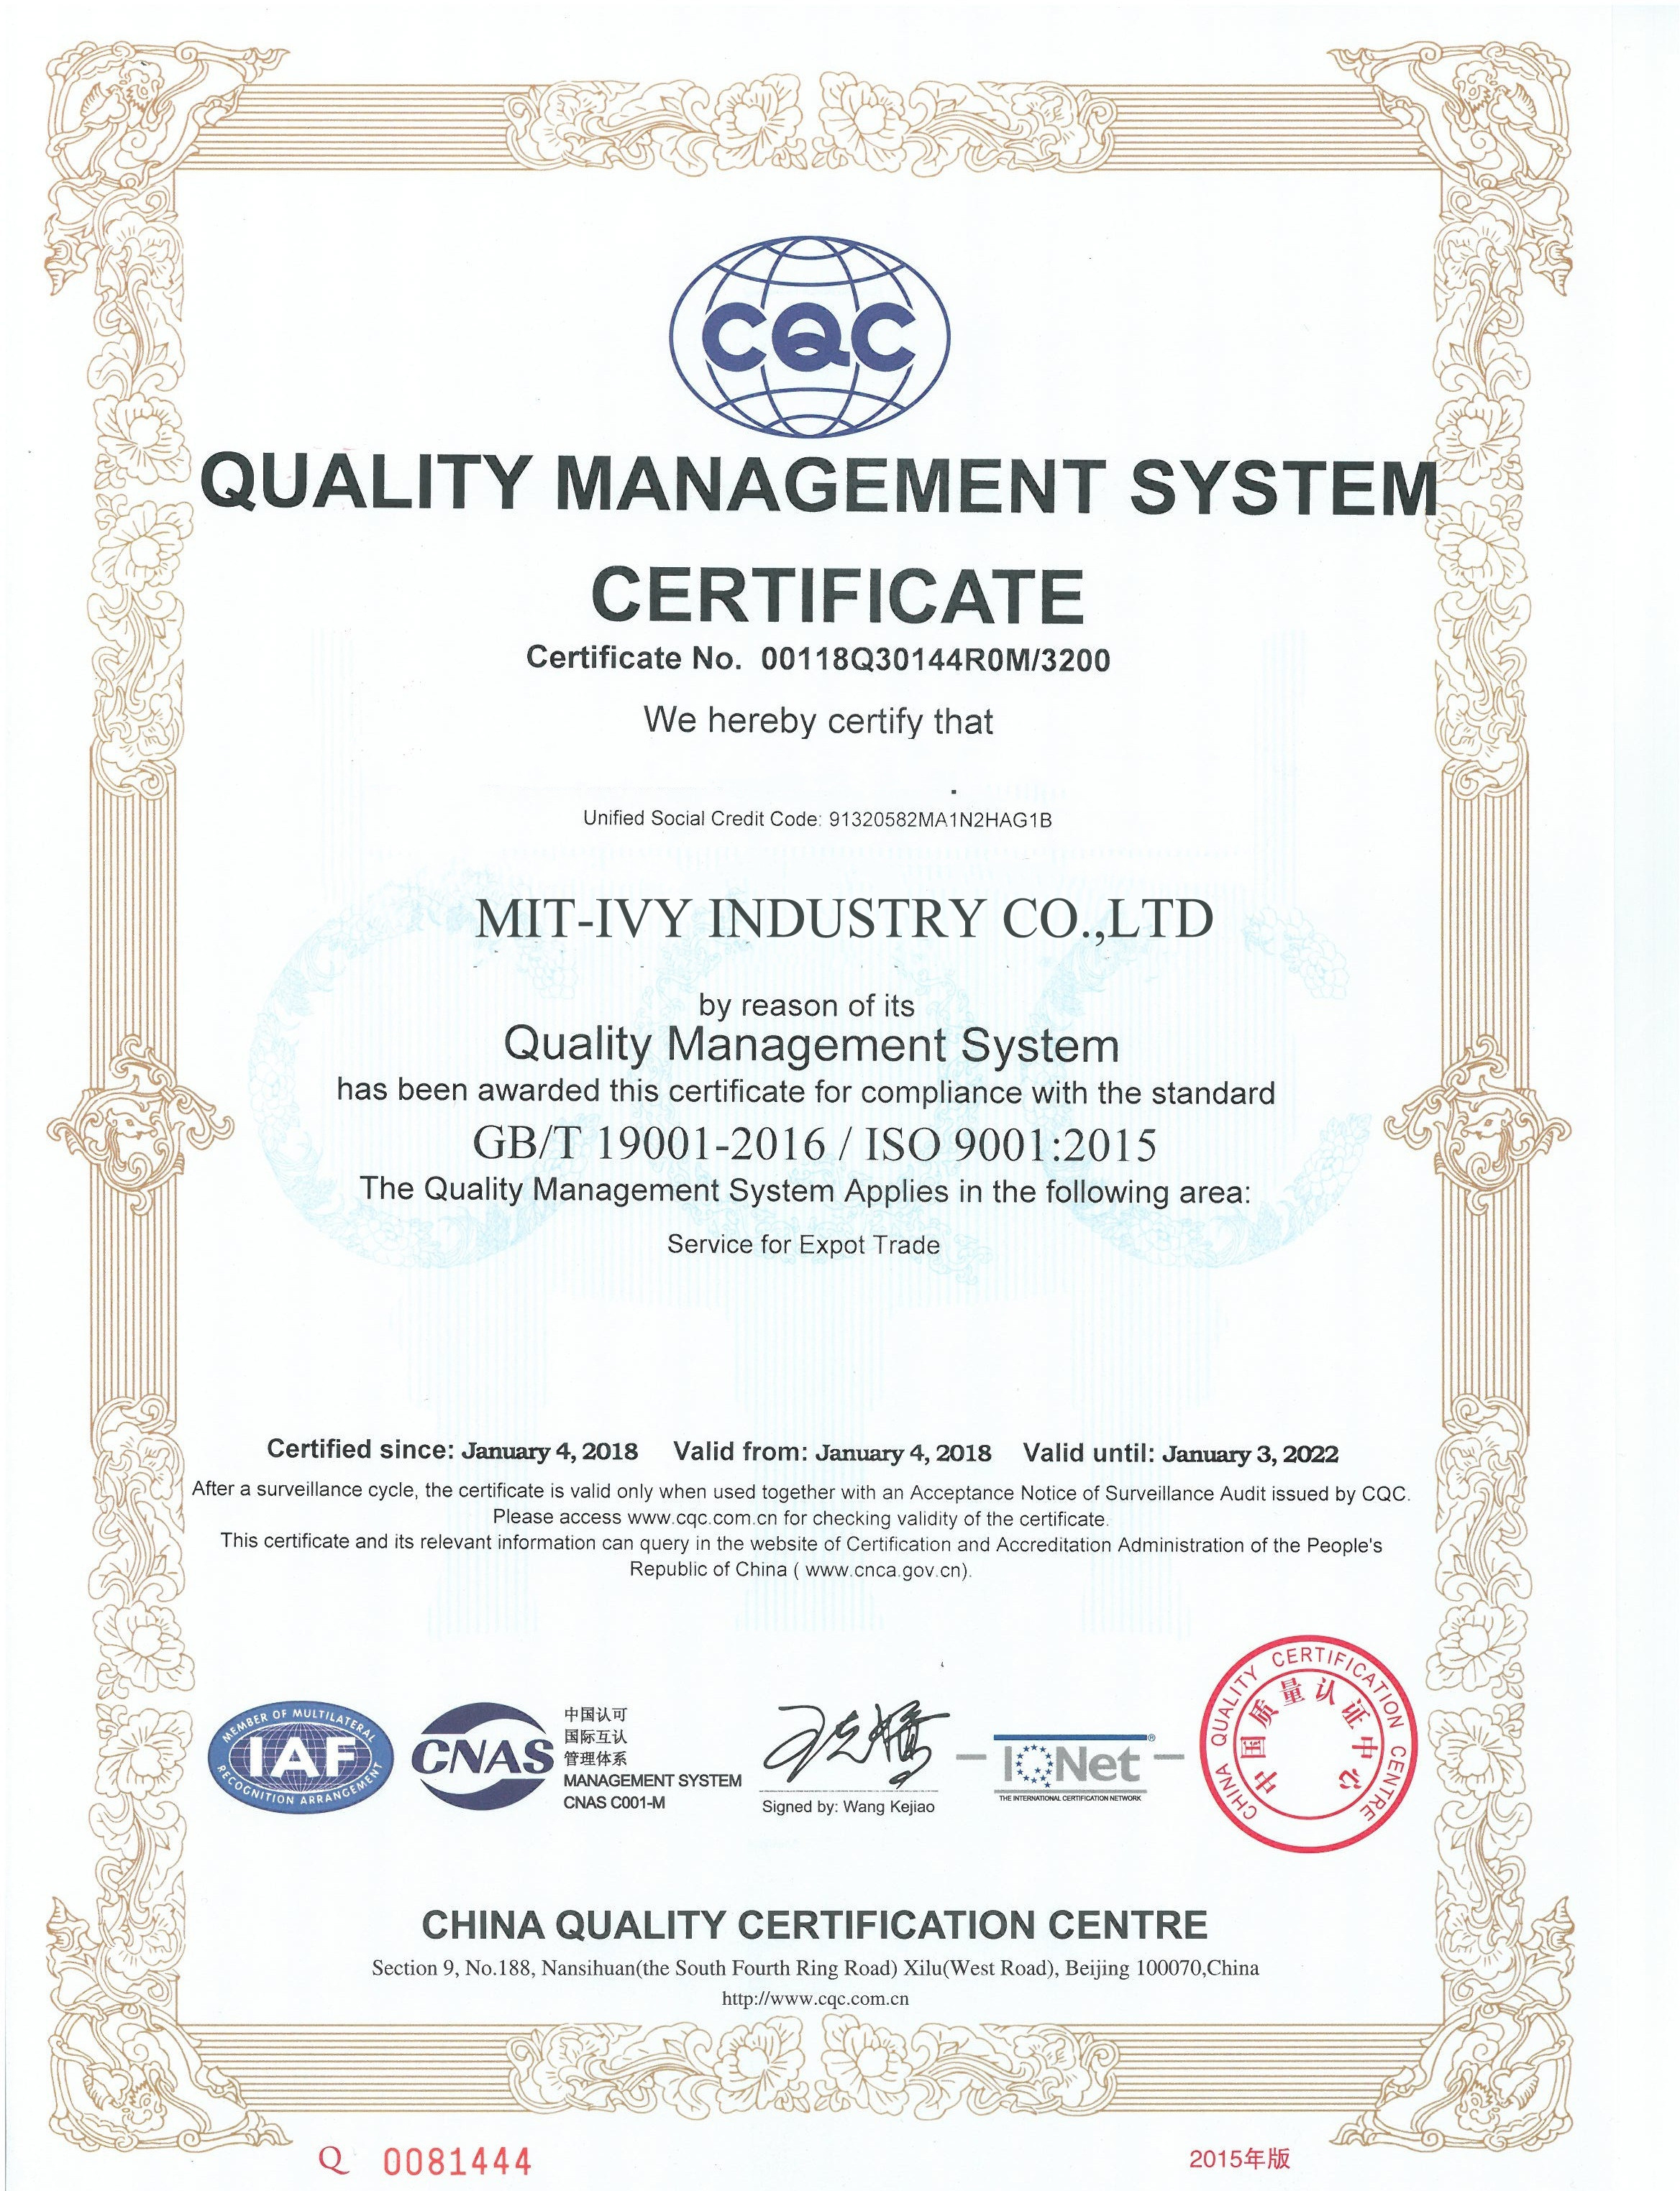
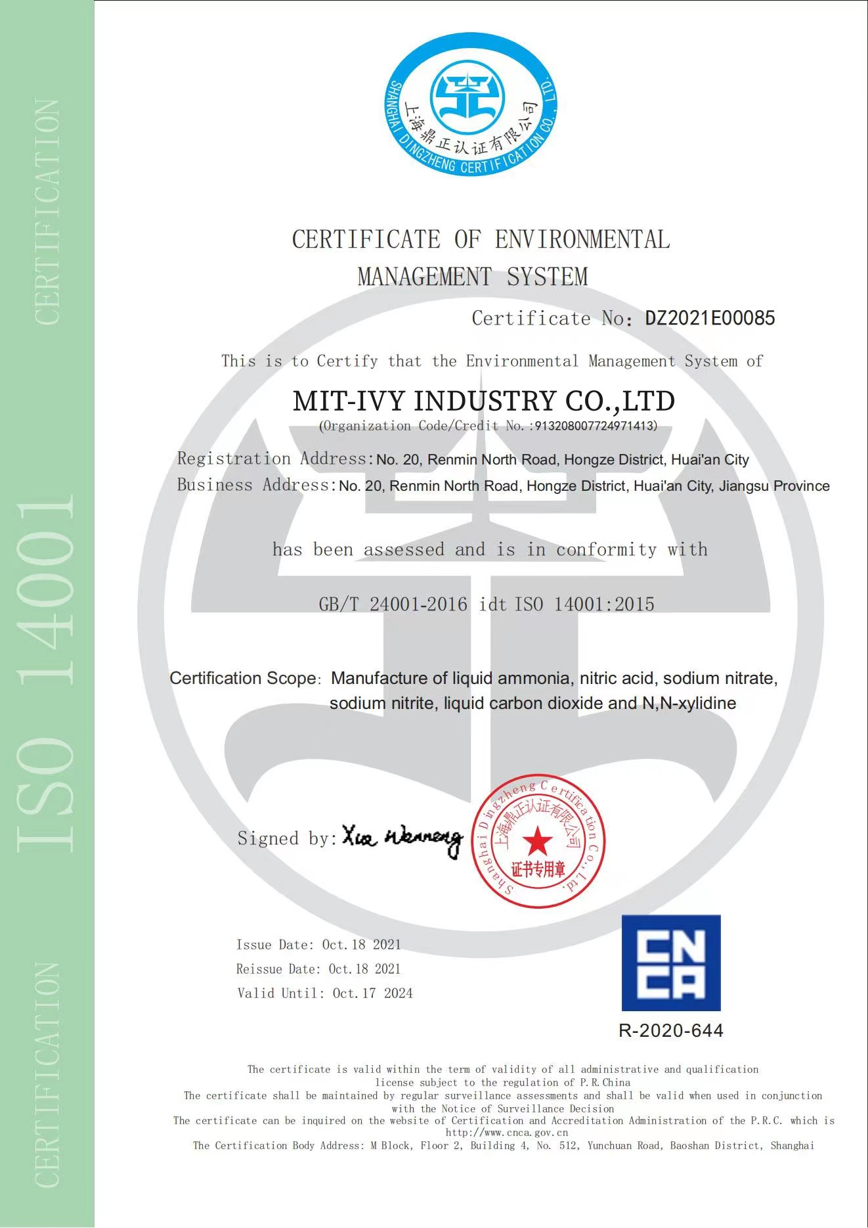
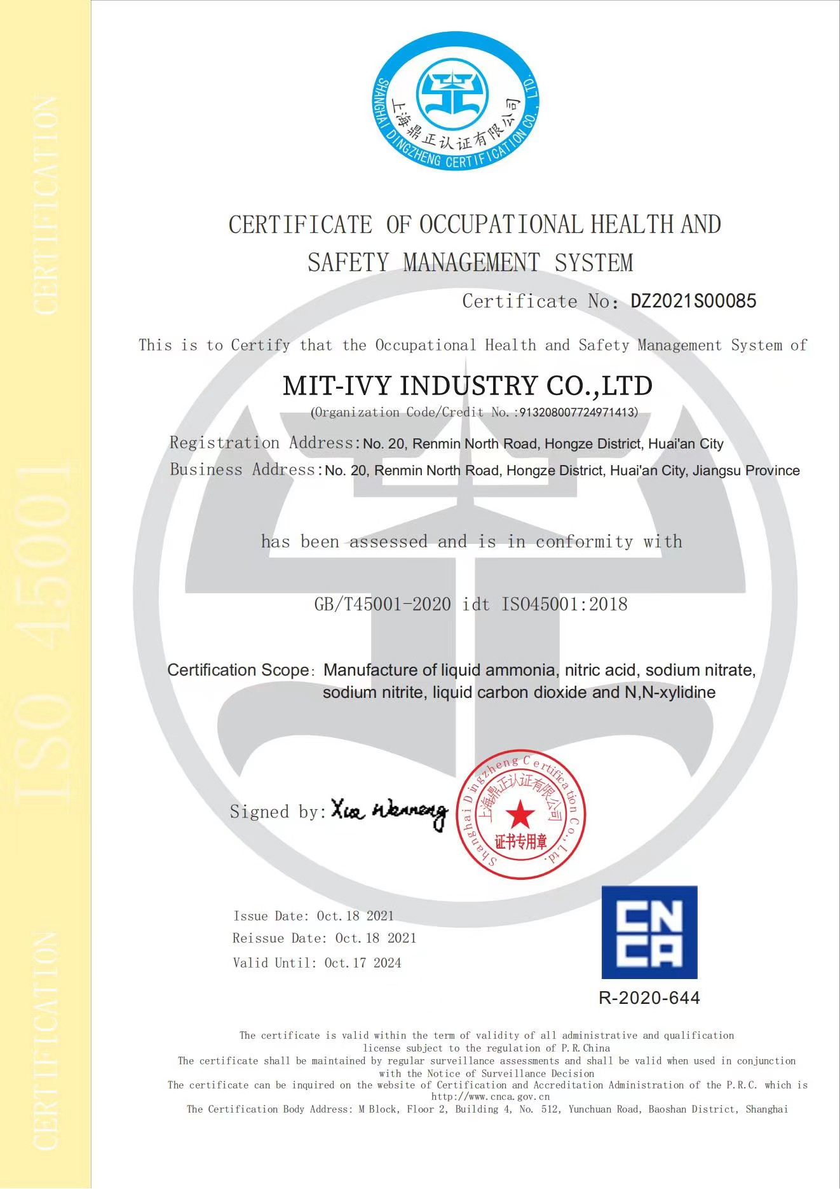
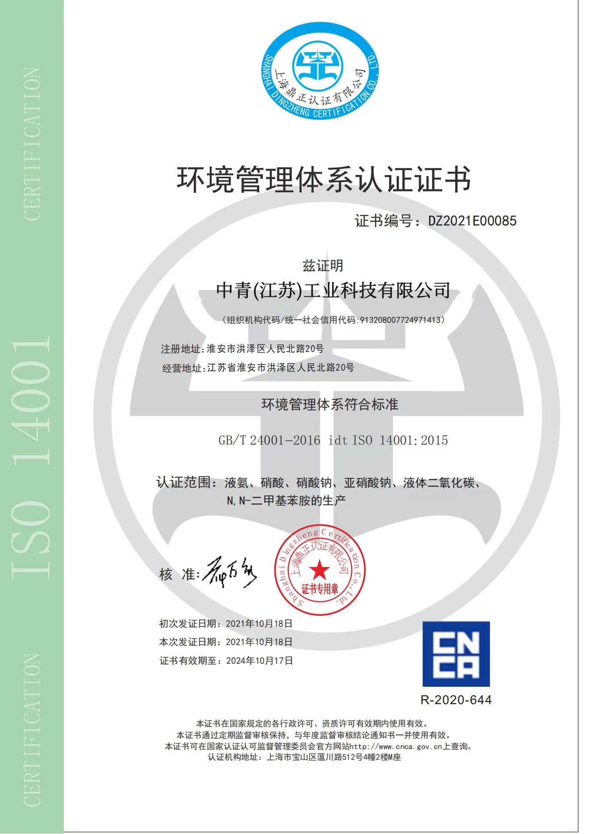
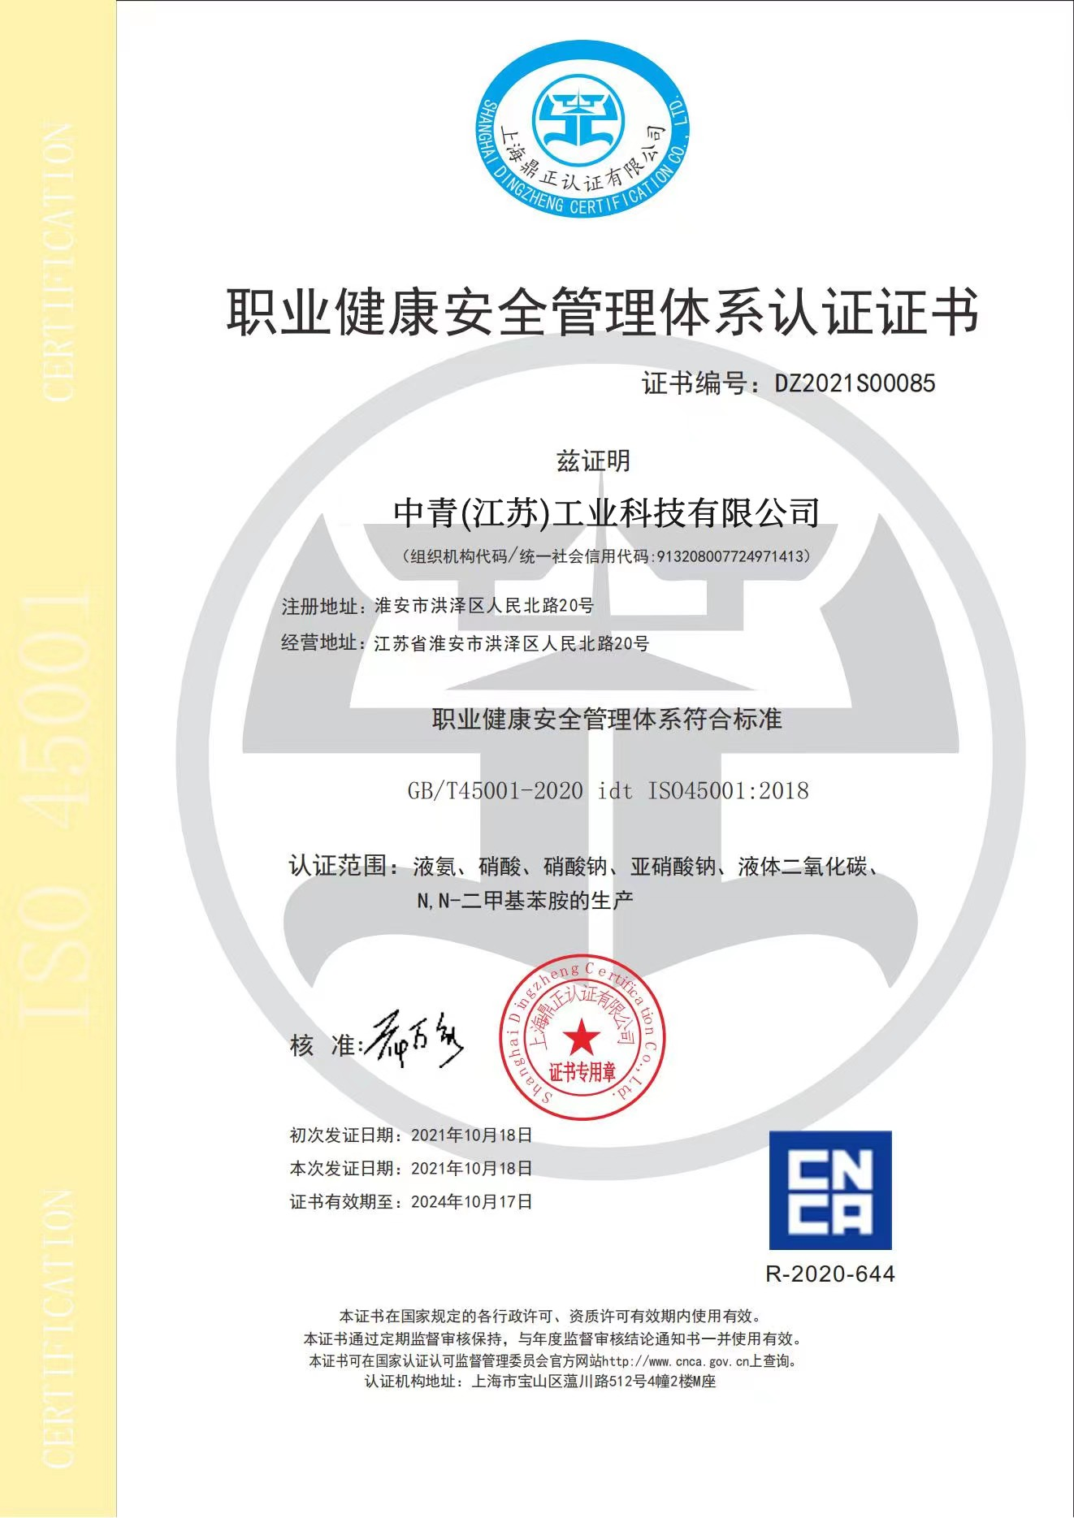
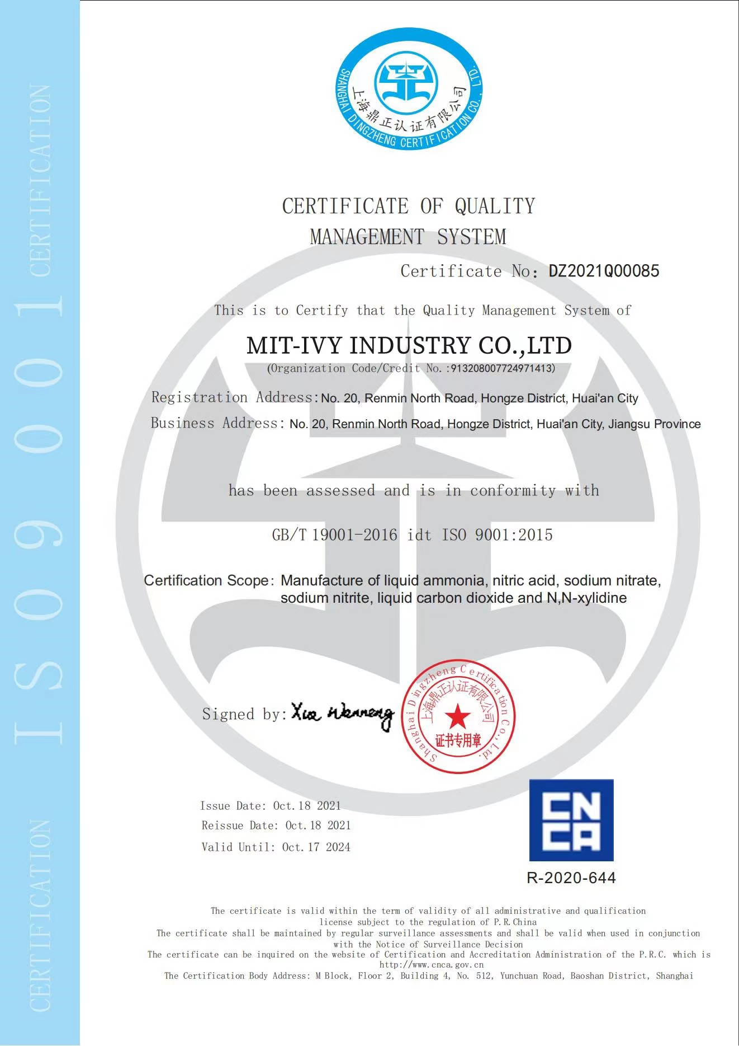
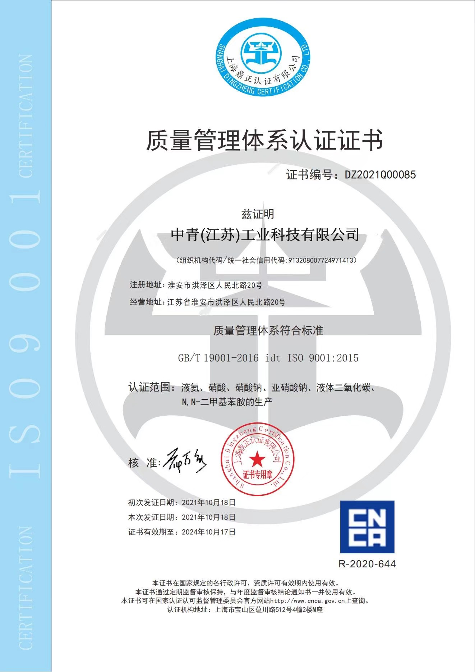
MIT-IVY Certificate

Slide 10

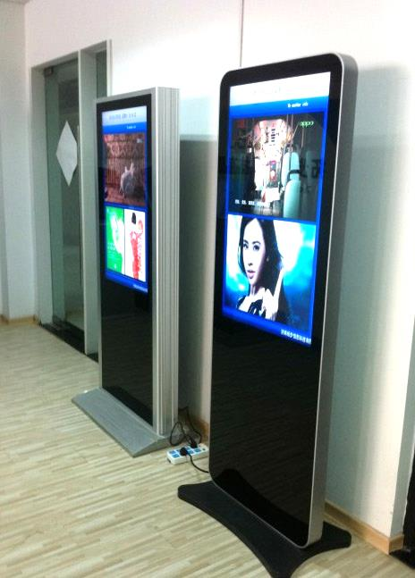
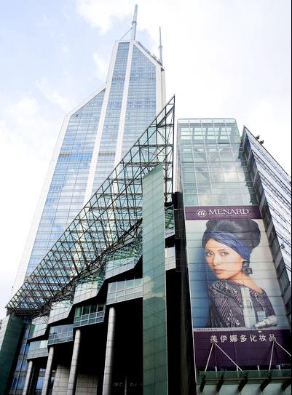
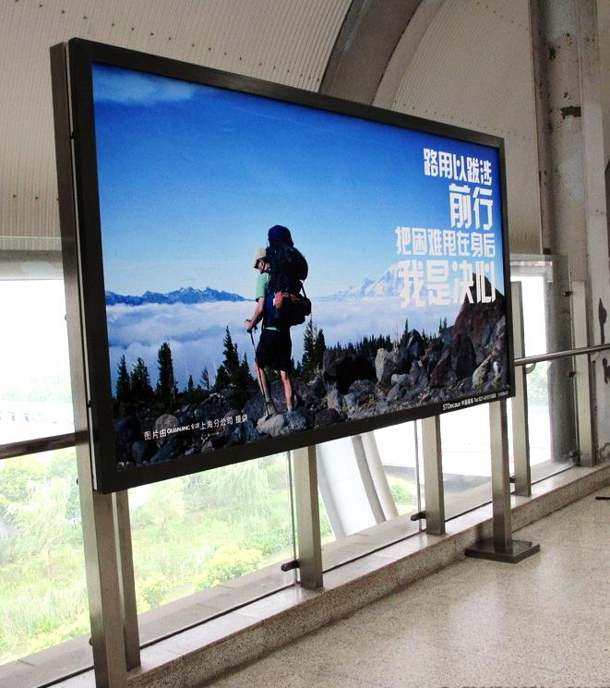
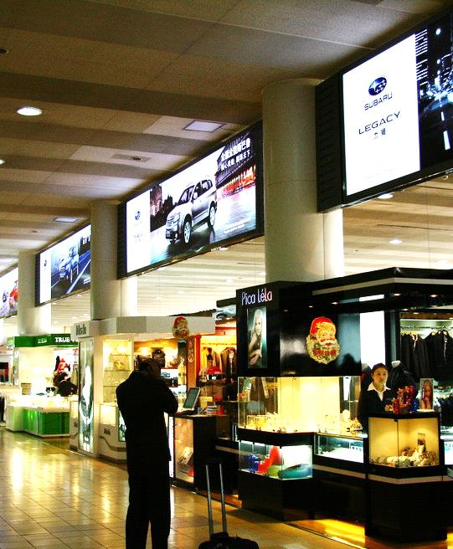
Company resources
capital
subsidiary
employee
Total area
Core technology
60 million
4
1500
500000
12

Slide 11
02
MIT-IVY INDUSTRY
COMPANY TEAM

Slide 12
Organizational structure
Board of directors
General manager
director
Fine chemical division
Strategic Planning
Financial center
Organization management center
Guangzhou MIT-IVY Industry
Science and technology Development
Financial accounting
Human resources
Changde Changlian Chemical Industry
Safety and Environmental Management Group
Analytical management
Infrastructure office
Anhui Yongchang Chemical Industry
Ministry of Justice
Finance department
Warehousing and logistics

Slide 13
03
MIT-IVY INDUSTRY
ENTERPRISE PRODUCTS

Slide 14
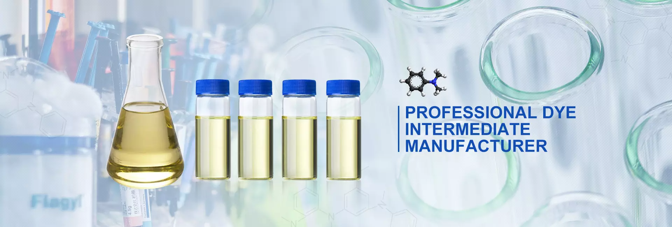
PRODUCT
Fine chemicals
organic intermediates
specialty chemicals

Slide 15
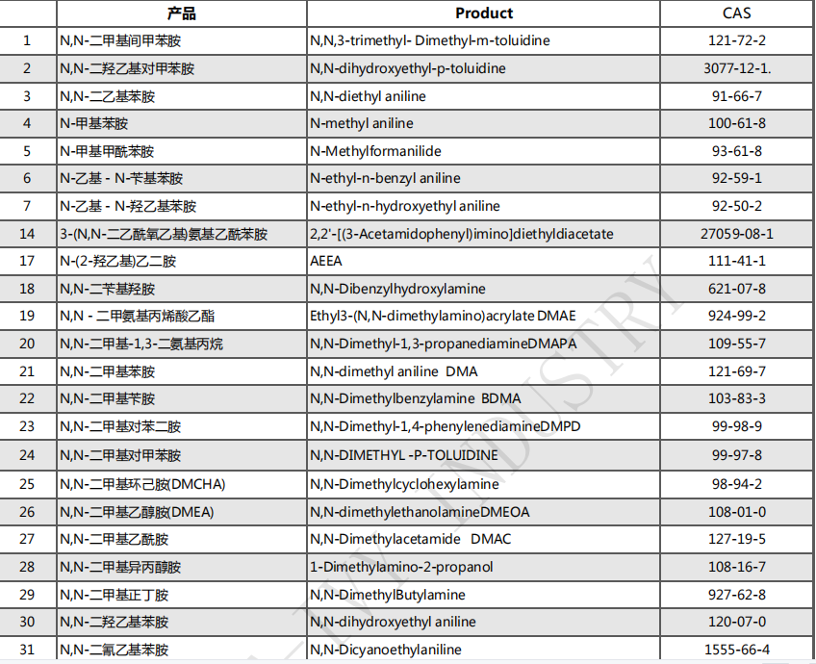

Slide 16
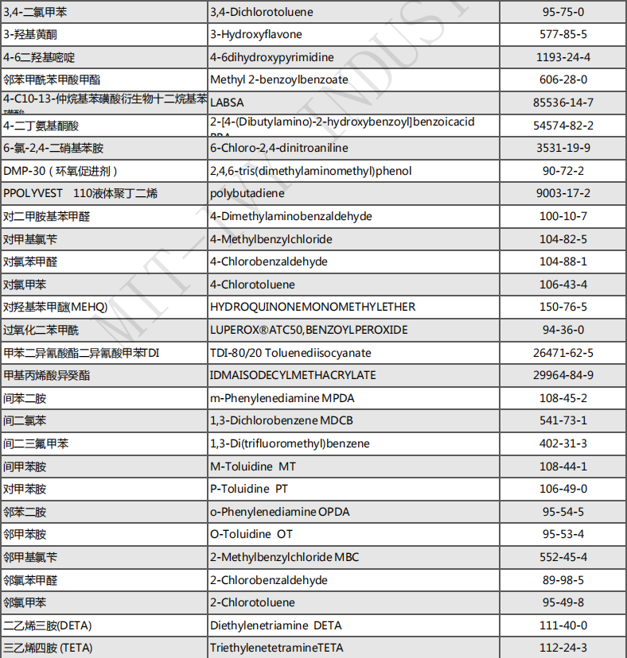

Slide 17
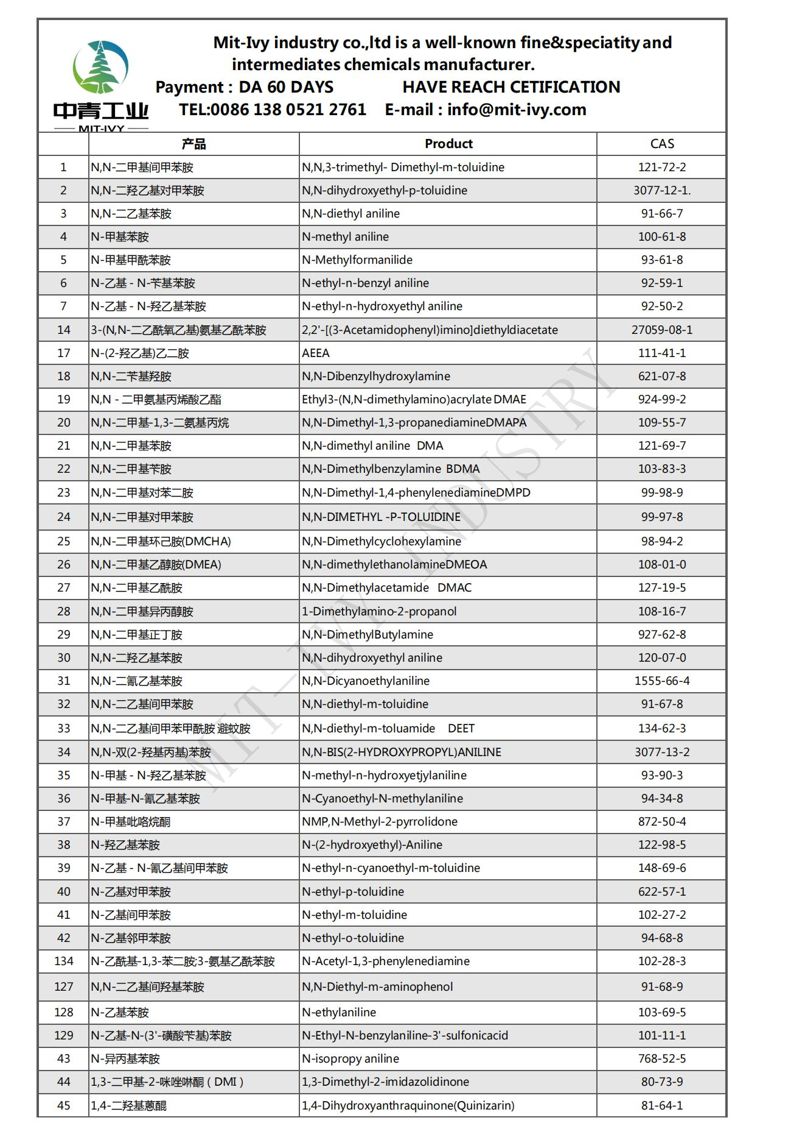
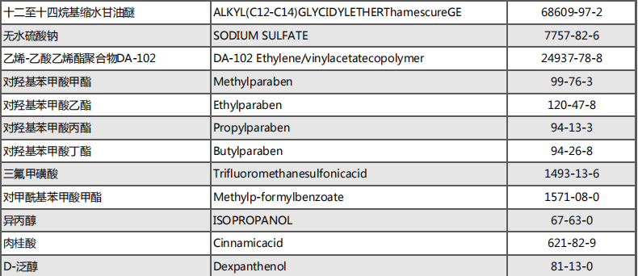

Slide 18
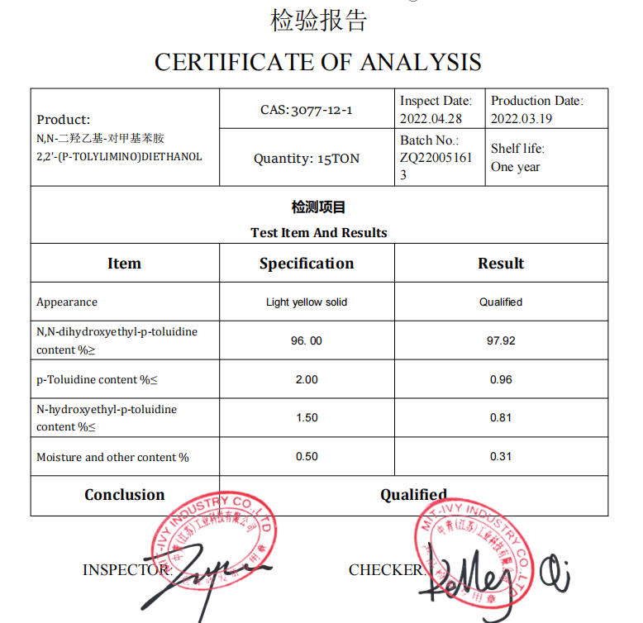
N,N-dihydroxyethyl-p-toluidine
CAS:3077-12-1

Slide 19
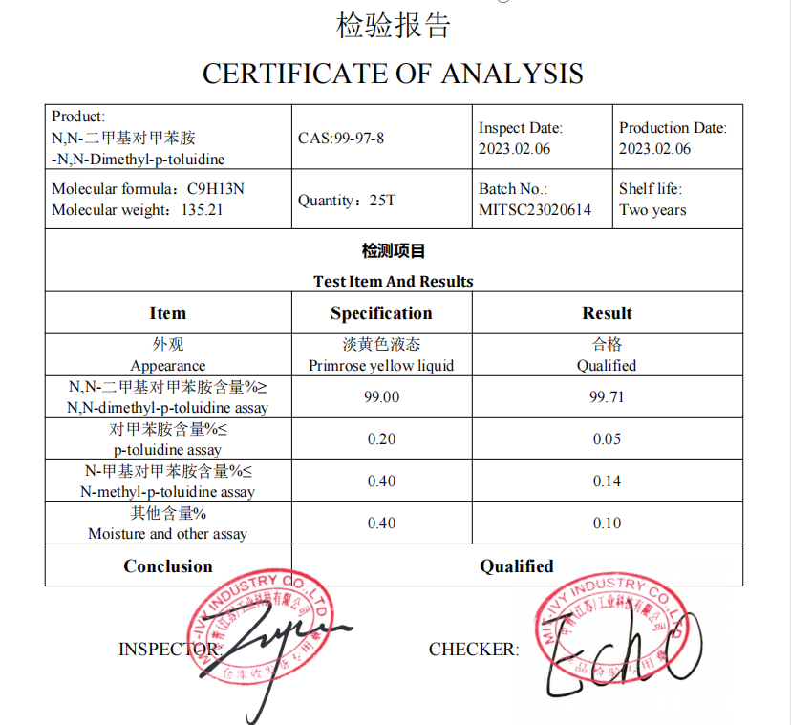
N,N-Dimethyl-p-toluidine
CAS:99-97-8

Slide 20
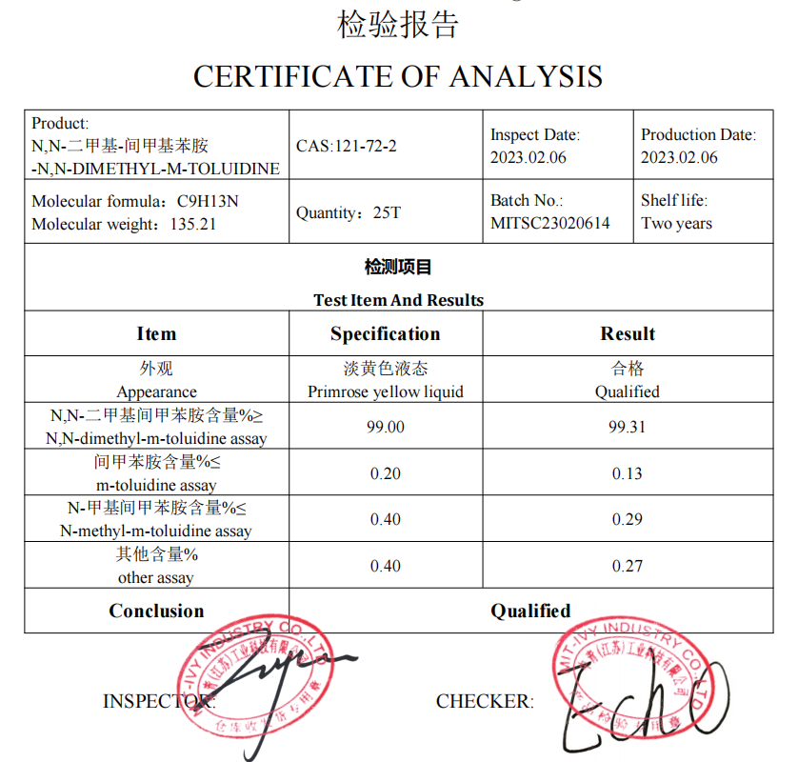
N,N-DIMETHYL-M-TOLUIDINE
CAS:121-72-2

Slide 21
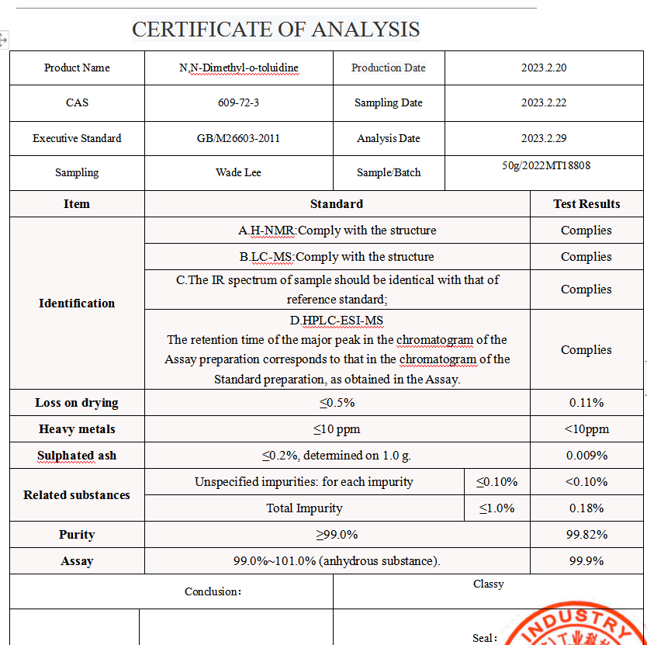
N,N-Dimethyl-o-toluidine
609-72-3

Slide 22
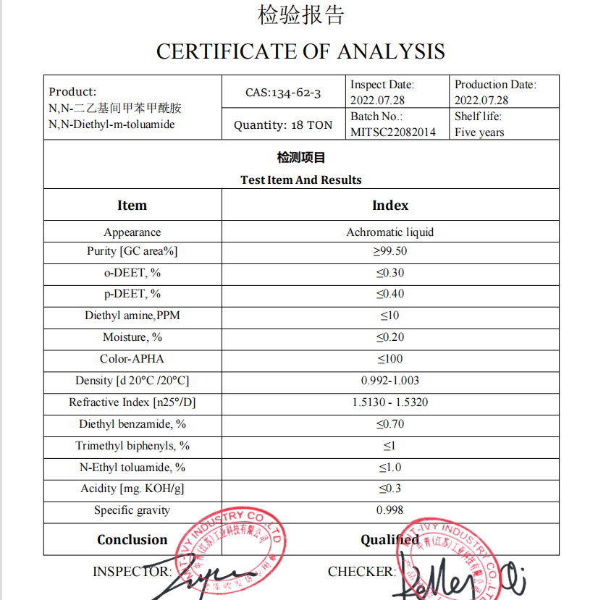
N,N-diethyl-m-toluamide DEET
CAS:134-62-3

Slide 23
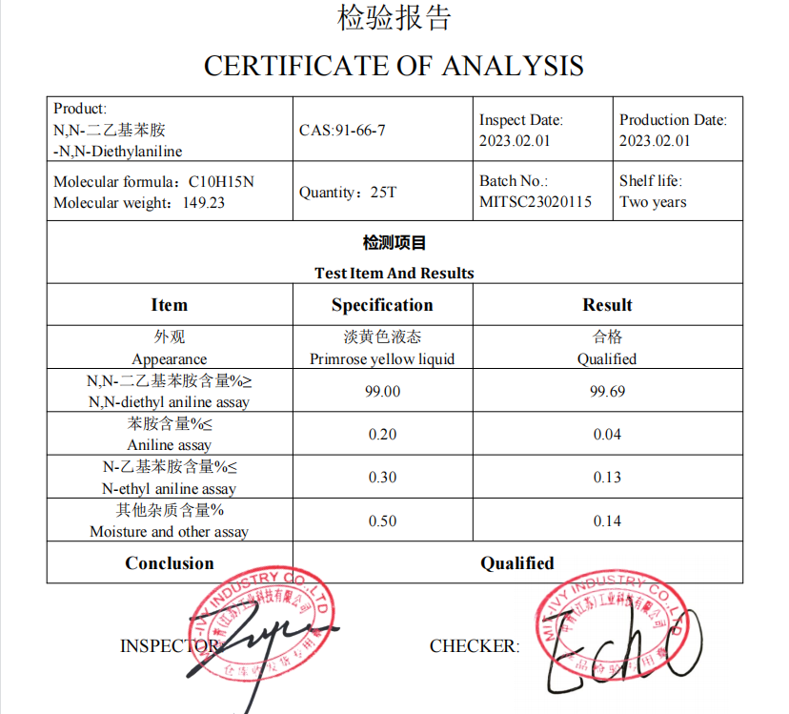
N,N-Diethylaniline
CAS:91-66-7

Slide 24
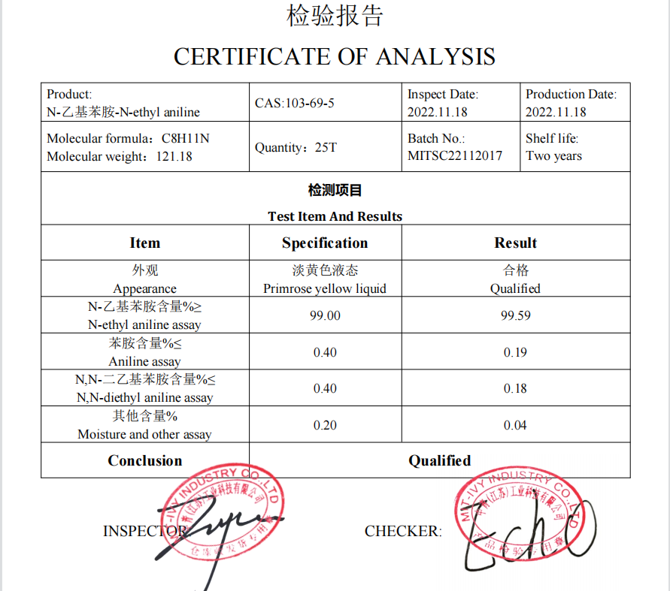
N-ethyl aniline
CAS:103-69-5

Slide 25
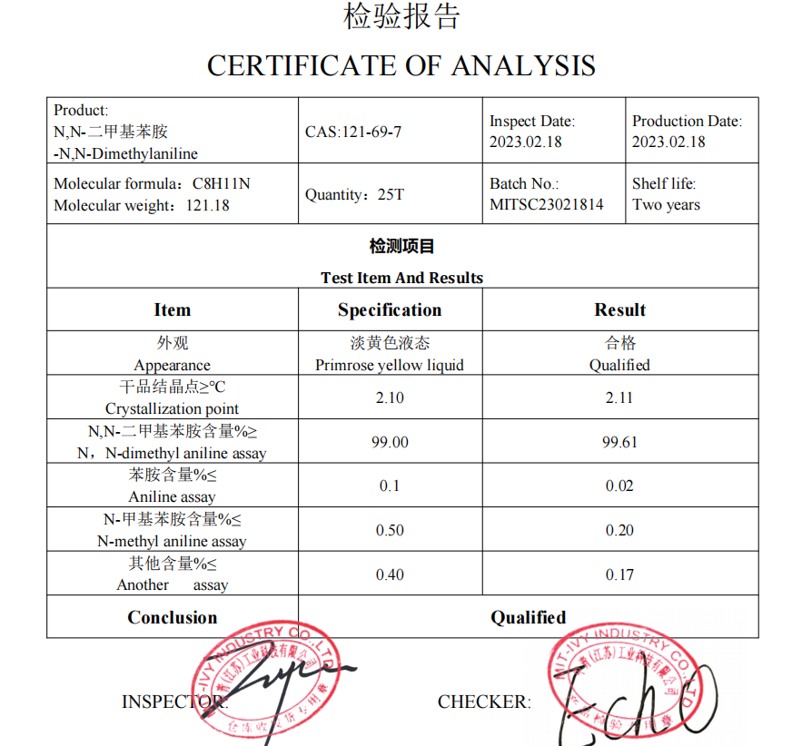
N,N-Dimethylaniline
CAS:121-69-7

Slide 26
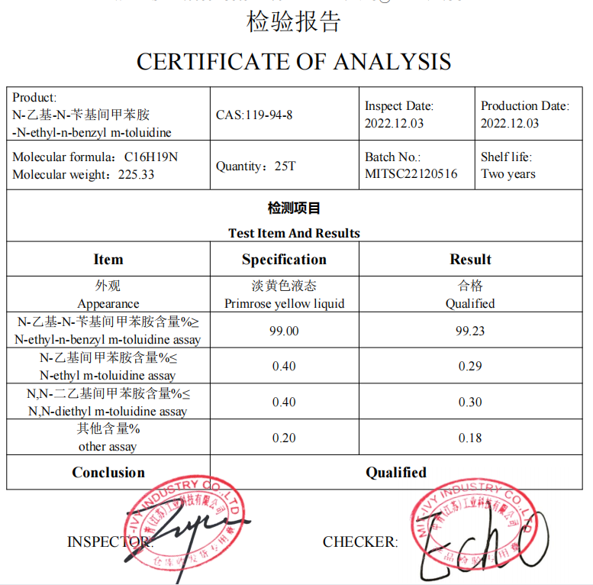
N-ethyl-n-benzyl-m-toluidine
CAS:119-94-8

Slide 27
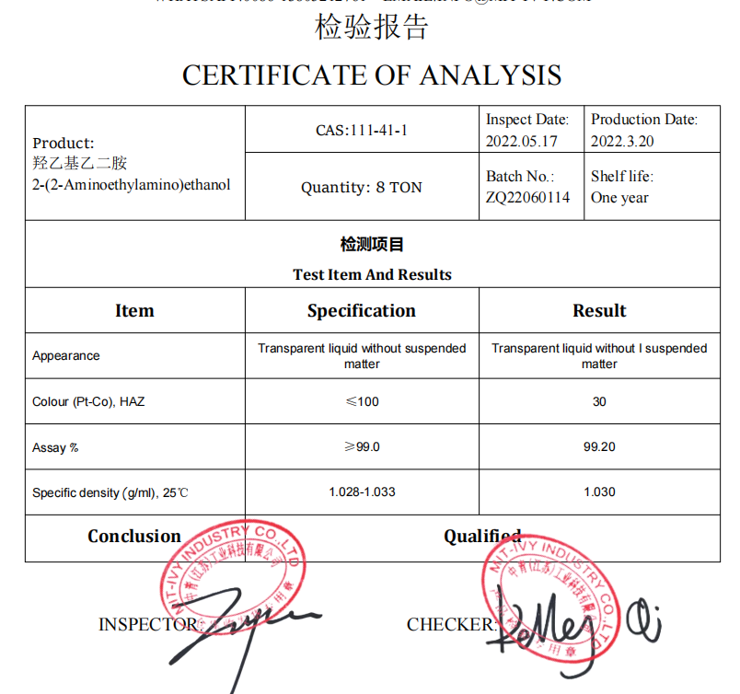
2-(2-Aminoethylamino)ethanol AEEA
CAS:111-41-1

Slide 28
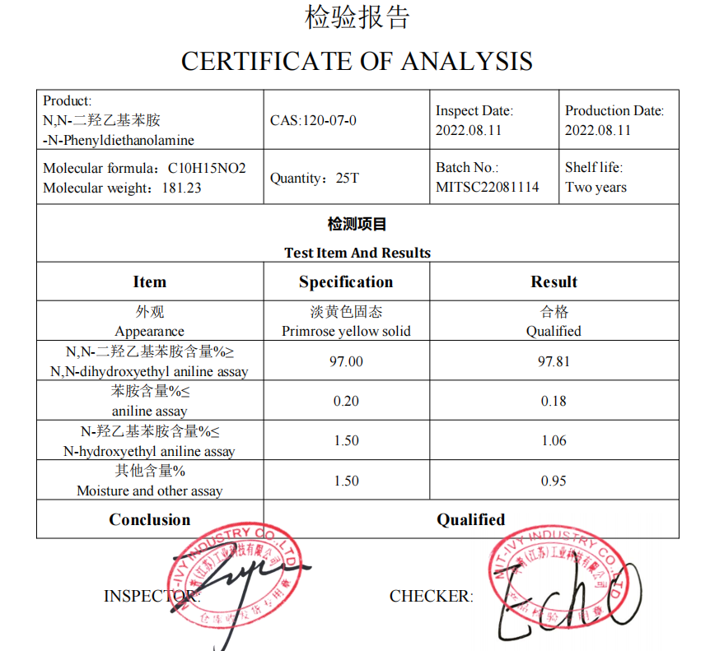
N-Phenyldiethanolamine
CAS:120-07-0

Slide 29
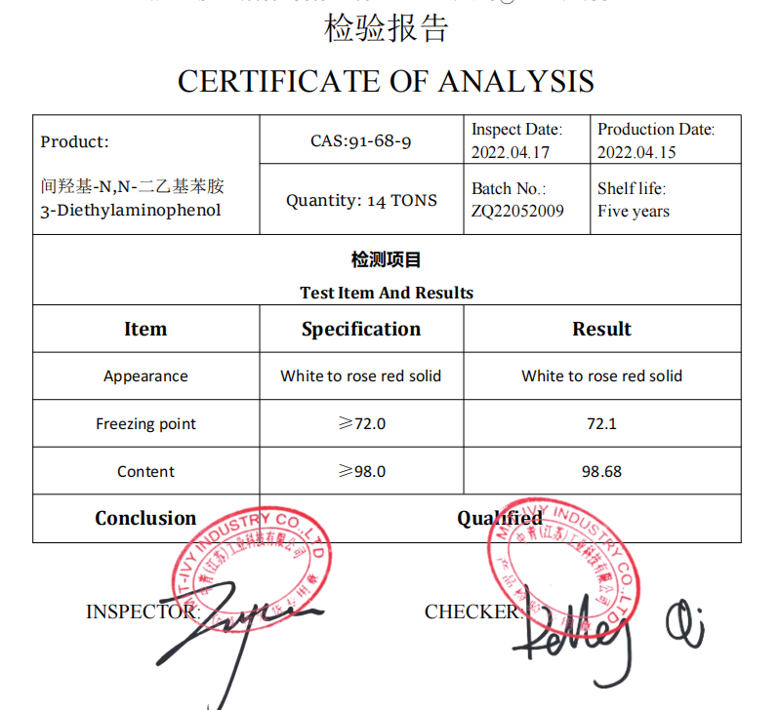
N,N-Diethyl-m-aminophenol
CAS:91-68-9

Slide 30
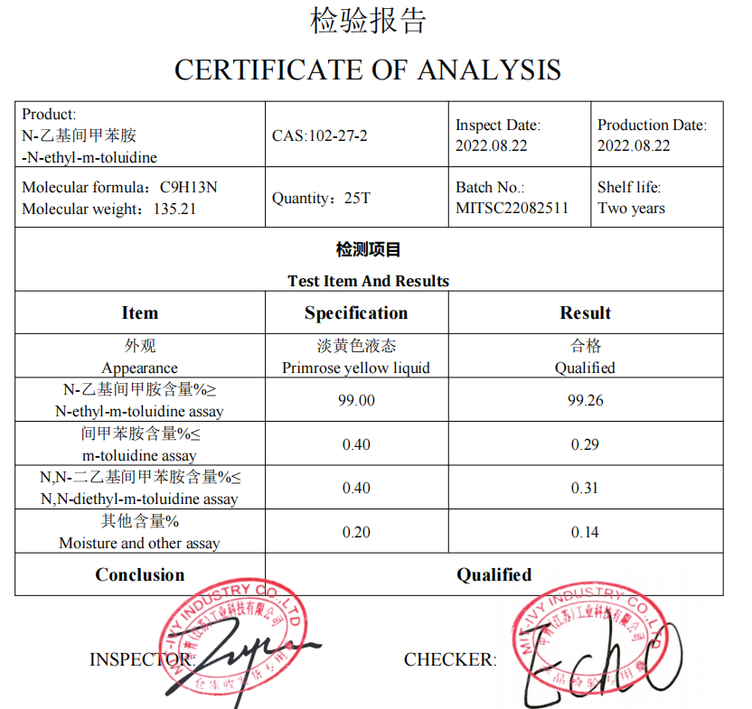
N-ethyl-m-toluidine
CAS:102-27-2

Slide 31
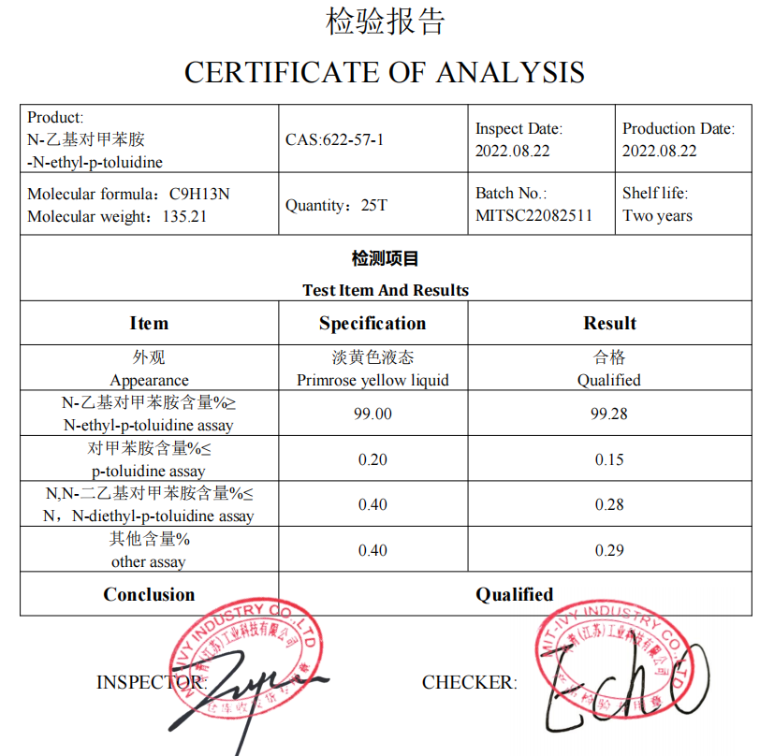
N-ethyl-p-toluidine
CAS:622-57-1

Slide 32
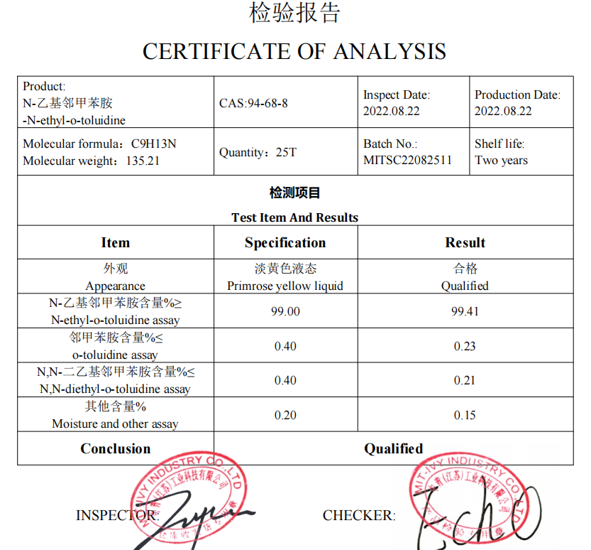
N-ethyl-o-toluidine
CAS:94-68-8

Slide 33
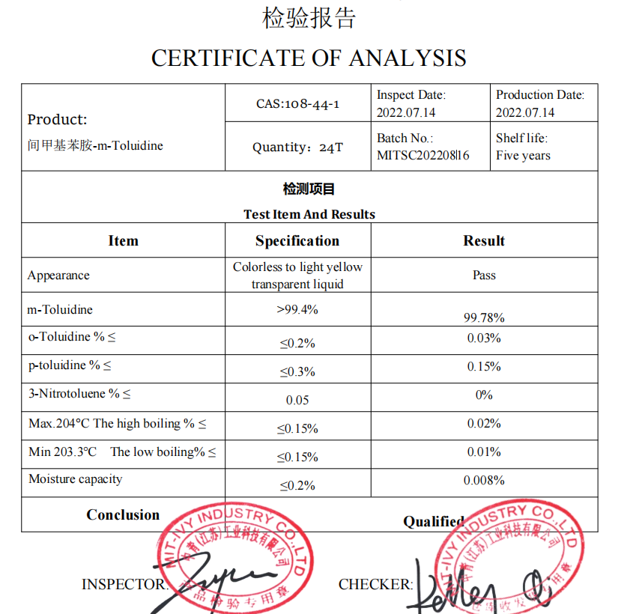
m-Toluidine
CAS:108-44-1

Slide 34
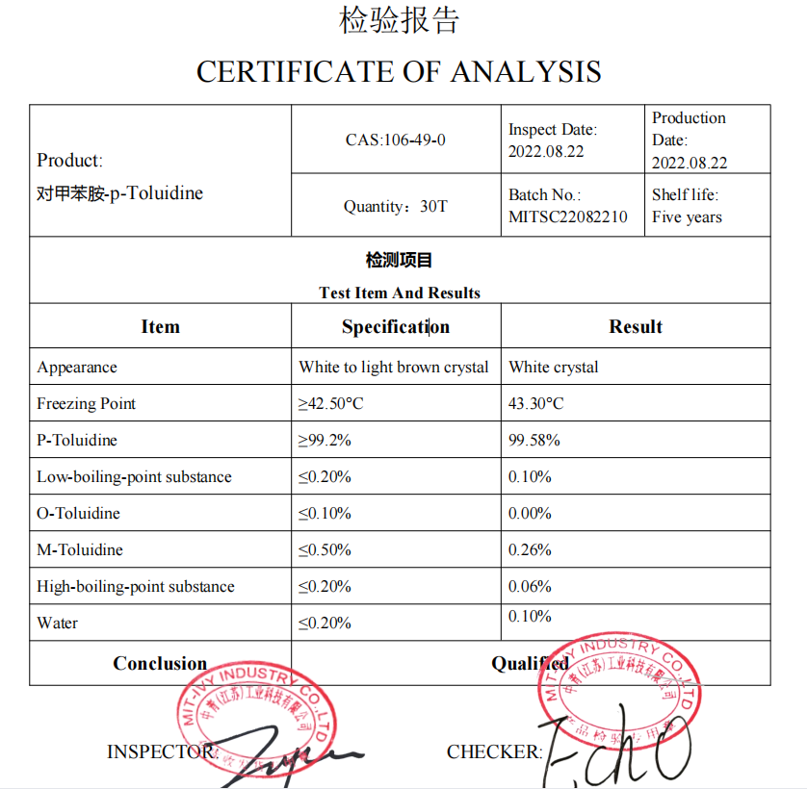
p-Toluidine
CAS:106-49-0

Slide 35
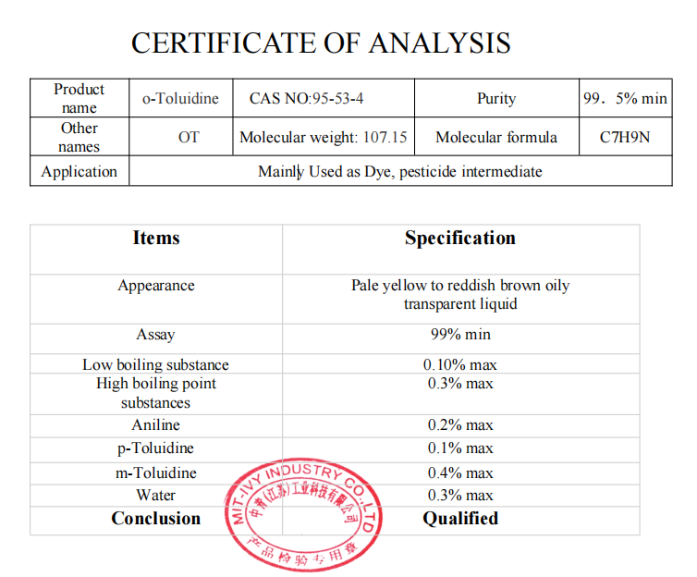
o-Toluidine
CAS :95-53-4

Slide 36
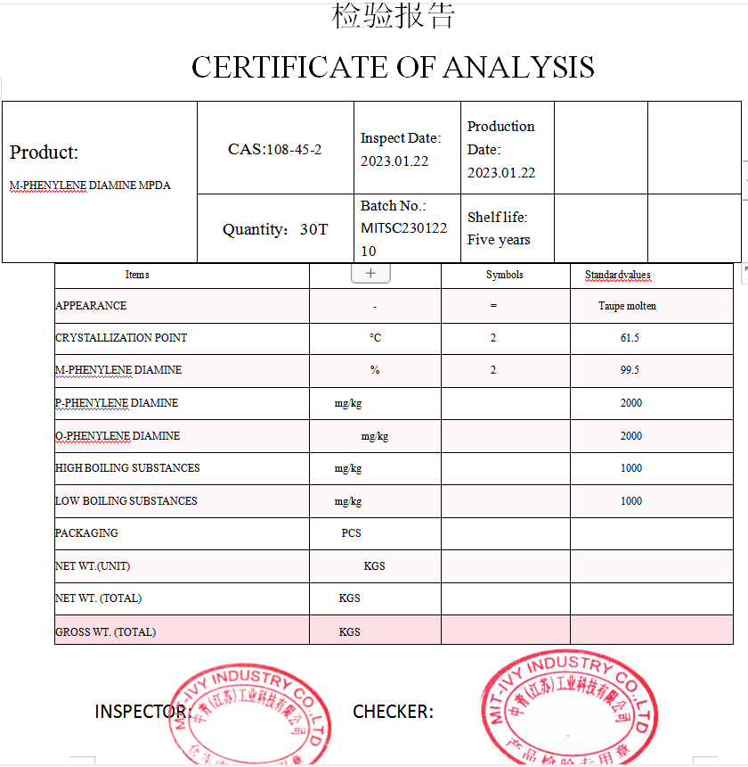
M-PHENYLENE DIAMINE MPDA
CAS:108-45-2

Slide 37
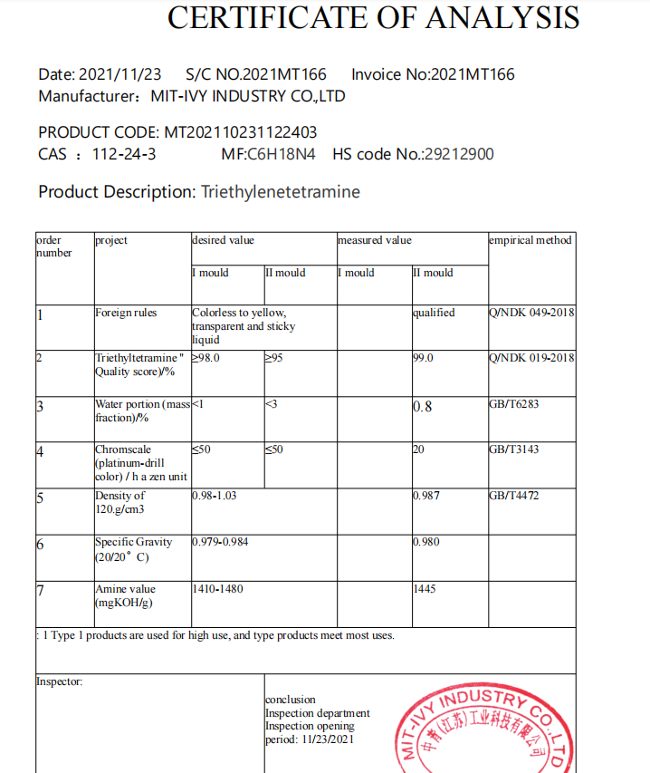
Triethylenetetramine
CAS ：112-24-3

Slide 38
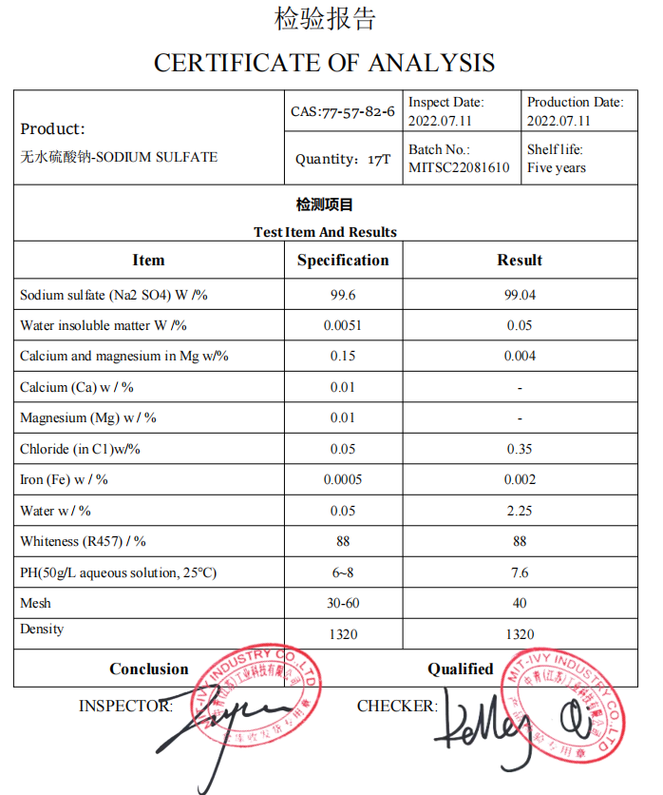
SODIUM SULFATE
CAS:77-57-82-6

Slide 39
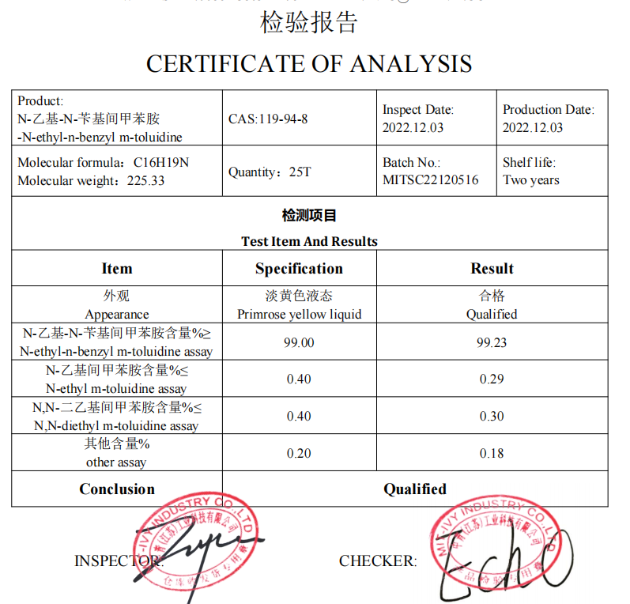
N-ethyl-n-benzyl-m-toluidine
CAS ：119-94-8

Slide 40

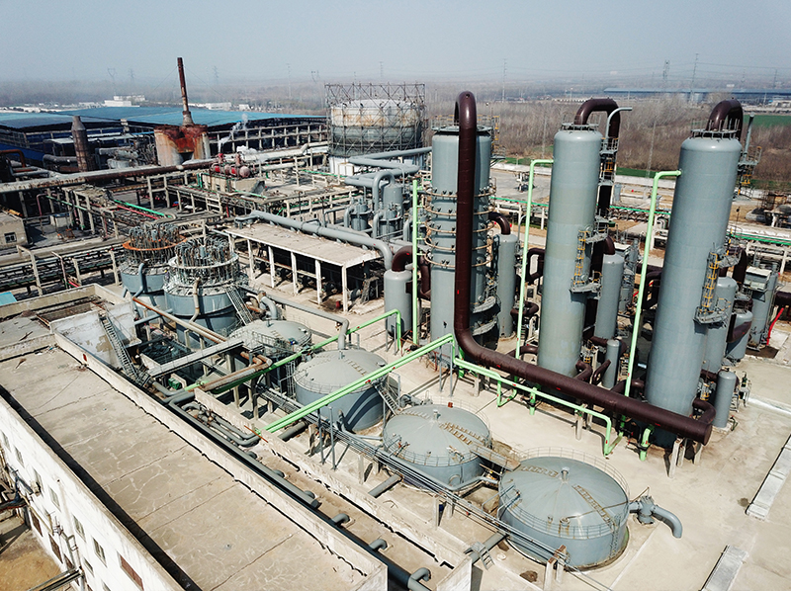

Company Advantages
5. Professional R&D technology team and equipment which keep products quality better and better..
1. Goverment support guarantees good company credibility and finance safe，so we can do DA 60 DAYS
6. Timely after-service resolves your worry for internation trade
2. MIT-IVY is confident at the quality of the products, and would like to supply free sample to our customers
3. Factory locates in national new material industrial park where guarantees safe and standard production enviroment
4. More than 23 years chemcial production and exporting experience, and good relationship with Customs and ship agents, which guarantee fast and safe export.

Slide 41



Our service
1. Certificate Of Analysis (COA)
2. Material Safety Data Sheet (MSDS)
3. Route of synthesis (ROS)
4. Method of Aanlysis (MOA)
5. Nuclear Magnetic Resonance (NMR)
6. Any inquiries will be replied within 12 hours.
7. Dedication to quality, supply & service.
8. Strictly on selecting raw materials.
9. Reasonable & competitive price, fast lead time.
10. Faster delivery:Sample order in stock and one week for bulk production.
11. We have strong cooperation with DHL, TNT, UPS, FEDEX, EMS. Or you also can choose your own shipping forwarder.

Slide 42
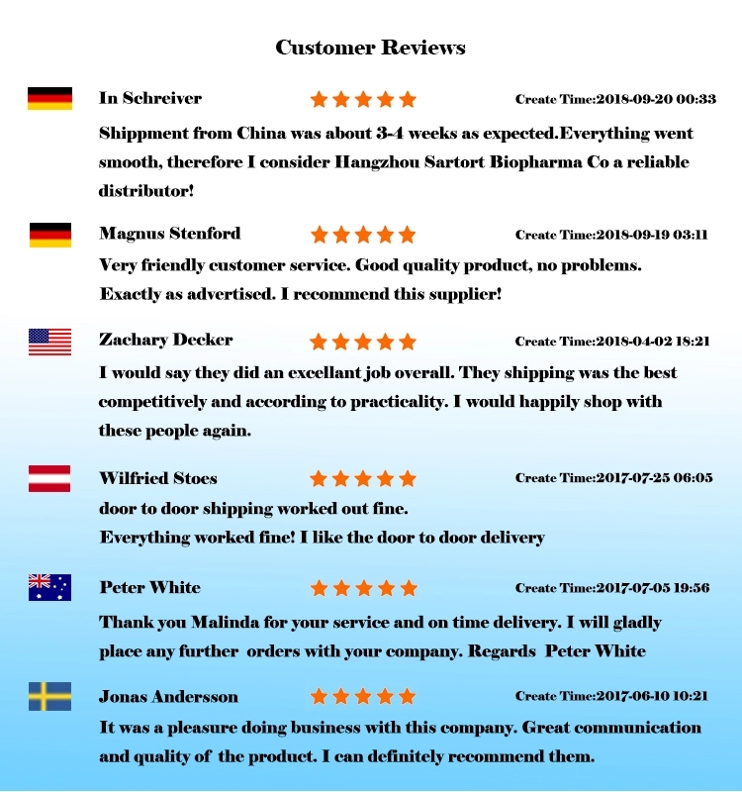
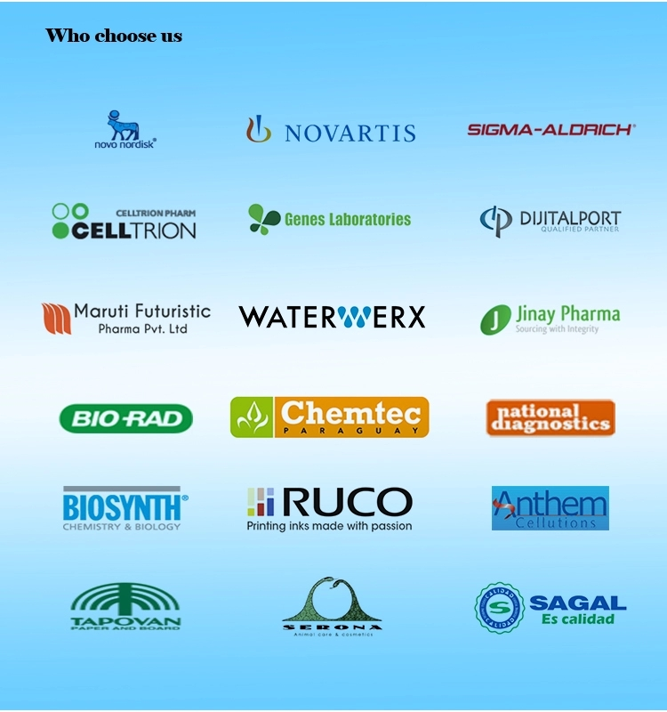
BEST CHOICE
Strategic cooperation

Slide 43
MIT-IVY INDUSTRY
观
谢
看
谢

